Slide 1

Video Shot Boundary Detection
1
Presented by
Ahmed Nour Code: 180011
Ahmed Mamdouh Code: 180010
Adham Hussien Code : 180011
Abdulrahman Taha Code : 180079
Mahmoud Mohamed Mahmoud Code : 180126
Mohamed Ahmed Farghali Code : 180101
Abdallah Ahmed Ibrahim Code : 180157
Youssef Shaaban Hamdahhah Code : 180154
Supervised by
Dr. Ahmed Elngar
Faculty of Computers and Artificial Intelligence
Beni-Suef University
Computer Vision: Video Shot Detection. Wednesday 22 -12-2021

Slide 2
Outline
Abstract
Introduction
Definitions
Techniques of Detection
Categories
Code & Run
Types of Shot
Advantages & Disadvantages
Conclusion

Slide 3
Abstract
Video image processing is a technique to handle the video data in an effective and efficient way. It is one of the most popular aspects in the video and image based technologies such as surveillance. Shot change boundary detection is also one of the major research areas in video signal processing. Previous works have developed various algorithms in this domain.

Slide 4
Introduction
Shot boundary detection (SBD) is necessary for automatic video indexing and browsing. It can be applicable for numerous applications like indexing in video database, video compression etc. The basic unit of any video is frame. The frame sequences are indexed by frame number.
After breaking the video, the obtained frames have identical size. Generally in every one second 25-30 frames are taken. A video shot is a sequence of interrelated consecutive frames taken by a single camera at a stretch. In general, shots are combined to produce a video. Scene may be consist of a single or multiple shots which describe a story unit within a video. Shot boundary detection is based on the identification of visual dissimilarity due to the transitions.
The mismatch between two frames generally found while shot change. This dissimilarity appears in different form which is categorized into two types: abrupt (as hard cut) and gradual (dissolve, fade in, fadeout, wipe). An abrupt shot change can be seen in single frame.

Slide 5
Definitions
Video shot: A video shot is defined as a sequence of frames captured by one camera in a single continuous action in time and space. Generally, it is a group of frames that have consistent visual characteristics, such as color, texture, and motion. Depending on whether the transition between shots is abrupt or gradual, shot boundaries can be classified into two types: cut and gradual transitions. The cut transition is the classic, abrupt change where one frame belongs to the disappearing shot and the next one to the appearing shot.
Gradual transitions: can be categorized into dissolve, wipe, fade out/in, etc., in accordance with the attributes of different editing effects. For the dissolve transition, the last few frames of the disappearing shot temporally overlap with the first few frames of the appearing shot. During the overlap transition, the intensity of the disappearing shot reduces from normal to zero (fade out), whereas the intensity of the appearing shot increases from zero to normal (fade in).

Slide 6
Cont..
In the fade transition, the disappearing shot fades out into a blank frame, afterwards the blank frame fades into the appearing shot. The wipe transition is in fact a set of shot change methods where the appearing and disappearing shots coexist in different spatial areas of the intermediary video frames, and the area taken by the former expands until it completely replaces the latter. The main focus of many recent works has been on abrupt transitions; gradual transitions are usually harder to identify, because of camera and/or object motions in a shot.

Slide 7
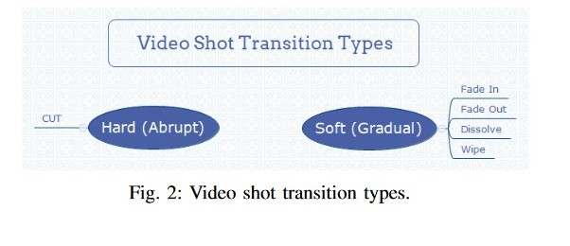
Cont..
Video shot detection: Shot detection has long been on focus in the content-based video analysis community. Over the past decade,
shot boundary detection (SBD) has been
seriously studied in video retrieval, video summarization,
pattern recognition, and multimedia communities.
In recent years, more research has been done on
automatic shot detection. Since 2001,
the TREC Video Retrieval (TRECVID) evaluation tested
has been created to carry out benchmark evaluations of
video shot detection tasks, and has notably improved
the development of SBD techniques. It shows that the detection of abrupt transitions has been tackled quite successfully, whereas the identification of gradual transitions is still a challenging problem.

Slide 8
Cont..
The video shot detection used (GED): In spite of the latest advances, SBD on large-scale video data is still a very difficult task, with many problematic issues. For example, the problem of how to devise an efficient, unified technique which identifies different types of transitions and is less sensitive to the amount of camera panning and zooming, video object motions, color, and illumination variability in the shot. For this purpose, we suggest a Generalized Eigenvalue Decomposition (GED)-based technique which is not dependent on the content of data and will be utilized to identify various types of transitions, maximize the efficiency of SBD, and decrease the computational cost. We have executed our resolution and assessed it in accordance with the TRECVID benchmark dataset. Our method produced hopeful results, compared with the best results reported in the TRECVID assessments.
Shot boundary detection (SBD) is necessary for automatic video indexing and browsing. It can be applicable for numerous applications like indexing in video database, video compression etc. The basic unit of any video is frame. The frame sequences are indexed by frame number.

Slide 9
Techniques of Detection
Histogram Intersection
Histogram is used to count or visualize the frequency of data (i.e. the number of occurrences) over units of discrete intervals, called bins. Histograms have many applications within data and image processing. In this example, we will create a histogram of the frequency of pixel values within a 256-bit image. This example will illustrate the use of local memory, and local and global atomic .
Edge Based Tracking
In this method, to determine the shot boundary detection, an edge change calculation is assisted by Edge change ratio and motion vector compensation.it is computationally expensive than the simple histogram-based method and not outperform it. It can be used to remove false positives in both cut and gradual shot change transition in presence flash light occurrences. A shot transition is detected if the position of the edge in the current frame is larger in difference from the positions in the previous frame.

Slide 10
Cont..
Adaptive Thresholding
Choosing the proper threshold value is an important criterion in both color histogram comparison and edge change tracking algorithms. An adaptive threshold can be a better option to enhance the shot change detection precision. It uses the local thresholds of the feature or similarity function to be compared, which may be histogram similarity and equivalent contextual region (ECR), respectively.
Motion Vector
In this method Motion Vector need to be computed from the compressed domain of video. Block Matching Algorithm used to extract the motion vectors. A video frame divided into number of blocks. The Block Matching Algorithm compares the block in current video frame to each and every block in the successive video frames. A shot transition or a any camera movement will be detected, if the block differences exceeds the defined threshold value. A camera movement within a shot can be considered as gradual transition. The accuracy of shot detection will be decreased with inappropriate selection of motion vectors by block matching algorithm.

Slide 11
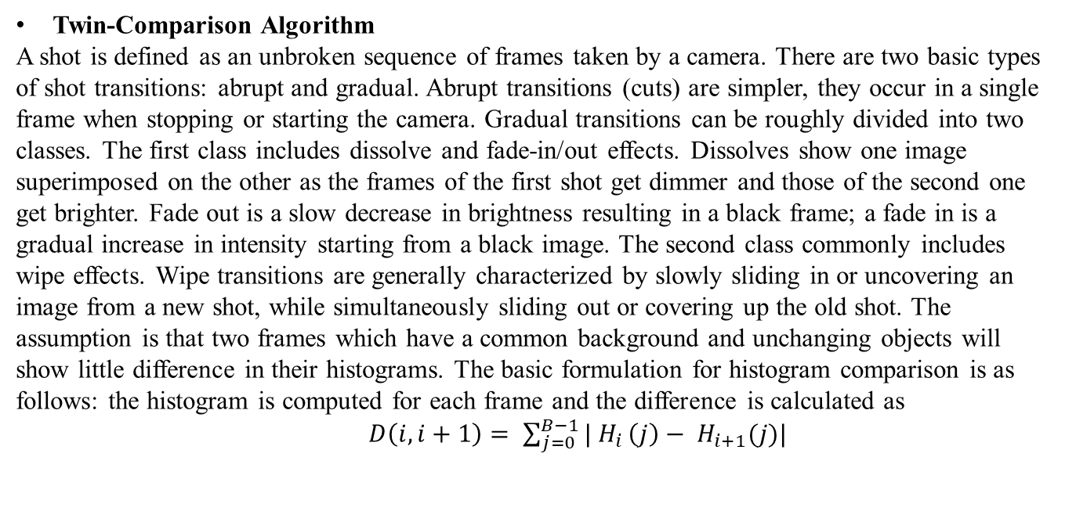
Cont..
Twin-Comparison Algorithm
A shot is defined as an unbroken sequence of frames taken by a camera. There are two basic types of shot transitions: abrupt and gradual. Abrupt transitions (cuts) are simpler, they occur in a single frame when stopping or starting the camera. Gradual transitions can be roughly divided into two classes. The first class includes dissolve and fade-in/out effects. Dissolves show one image superimposed on the other as the frames of the first shot get dimmer and those of the second one get brighter. Fade out is a slow decrease in brightness resulting in a black frame; a fade in is a gradual increase in intensity starting from a black image. The second class commonly includes wipe effects. Wipe transitions are generally characterized by slowly sliding in or uncovering an image from a new shot, while simultaneously sliding out or covering up the old shot. The assumption is that two frames which have a common background and unchanging objects will show little difference in their histograms. The basic formulation for histogram comparison is as follows: the histogram is computed for each frame and the difference is calculated as
$D\left(i,i+1\right)= \sum_{j=0}^{B−1}{| H_{i}}\left(j\right)− H_{i+1}(j)|$

Slide 12
Categories
Pixel Comparison: Pixel difference between two successive video frames or the percentage of pixels that has been changed in two successive frames is compared. This approach is sensitive to fast object and camera movement, camera panning or zooming.
Statistical differences: Frames are divided into small regions and statistical feature of each pixels within these regions are calculated of each successive frames. Calculated standard deviation as well as the mean of the gray levels in various regions of the images. This approach is noise tolerant, but slow due to complex statistical computation.
Likelihood Ratio: It minimizes the problem of false detection due to camera movements. Without comparing the pixels, likelihood ratio compares statistical features known as likelihood ratio of the corresponding regions or blocks in two successive frames. If the likelihood ratio is larger than the threshold, then it is assumed that region is changed.

Slide 13
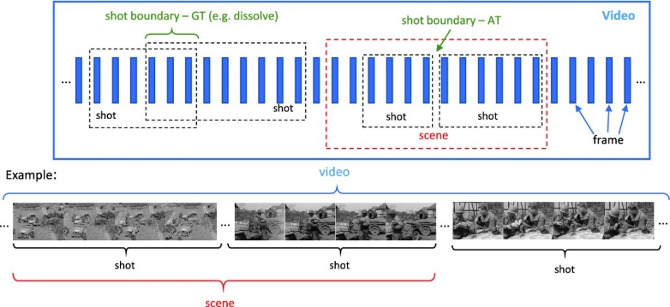
Categories
Histogram-Based Difference: Color histogram of each frame is calculated and compared among each other to detect shot boundaries. If the bin-wise difference among the two histograms becomes larger than the preset threshold, then a shot boundary is detected. In order to detect shot boundaries, applied the color histogram change rate.

Slide 14
Video Shot (Motion) Detection with Python

Slide 15
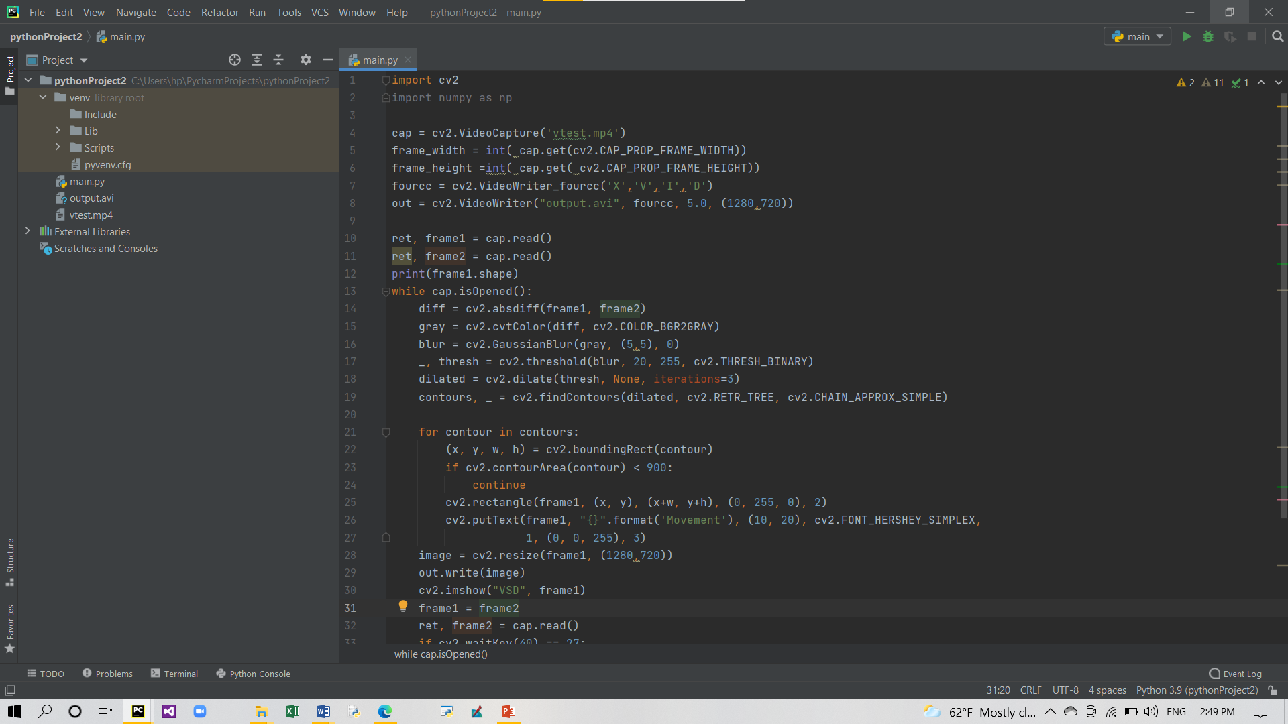
Code

Slide 16
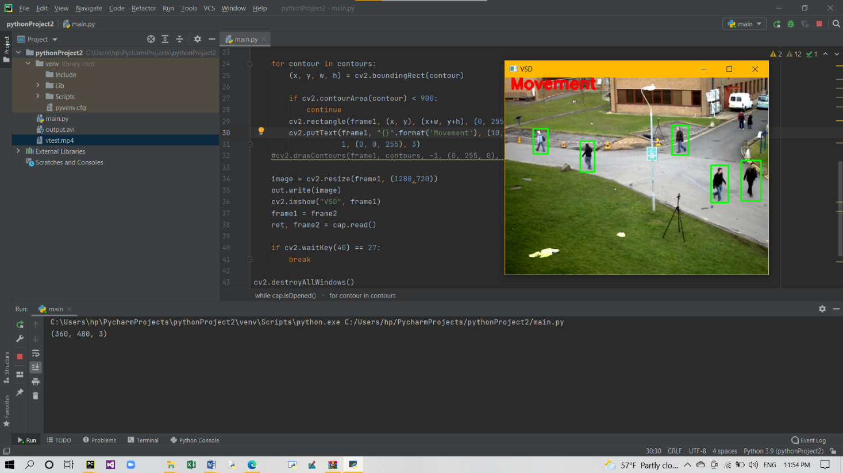
Run

Slide 17

Run

Slide 18
Cont..
We divide the video into frames and then we compare each two sequence farmes (x,y) and determine the change which happened between x,y and put contour to every change has been happened. Then frame x will equal frame y and frame y equal the next frame and the operation will recursive until the video finished.

Slide 19
Types of Shots
Cut: the most common transition an instant change from one shot to the next. The raw footage from your camera contains cuts between shots where you stop and start recording (unless of course you use built-in camera transitions). In film and television production, the vast majority of transitions are cuts.
Dissolve: these are all terms to describe the same transition a gradual fade from one shot to the next. Crossfades have a more relaxed feel than a cut and are useful if you want a meandering pace, contemplative mood, etc. Scenery sequences work well with crossfades, as do photo montages. Crossfades can also convey a sense of passing time or changing location.
Fade: Fades the shot to a single color, usually black or white. The "fade to black" and "fade from black" are ubiquitous in film and television. They usually signal the beginning and end of scenes. Fades can be used between shots to create a sort of crossfade which, for example, fades briefly to white before fading to the next shot.

Slide 20
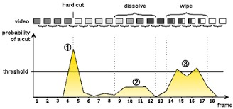
Cont..
Wide: One shot is progressively replaced by another shot in a geometric pattern. There are many types of wipe, from straight lines to complex shapes. Wipes often have a colored border to help distinguish the shots during the transition. Wipes are a good way to show changing location.
Digital Effects: most editing applications offer a large selection of digital transitions with various effects. There are too many to list here, but these effects include color replacement, animated effects, pixelization, focus drops, lighting effects, etc.
Many cameras also include digital effects, but if possible
it isbetter to add these in post-production.

Slide 21
Advantages
A wide range of use
Perimeter Surveillance: Thermal cameras connected to video analytics software can detect movement even in darkness and warn of trespass in real time.
Traffic Monitoring: Object identification in live traffic streams reveal vehicle pileups and possible road congestion.
Attendance Tracking: Cameras capture them entering the workspace and facial recognition systems identify individuals to automatically mark their attendance.
Queue Monitoring: This allows management to proactively step in to reduce wait times and crowding at customer service points.

Slide 22
Cont..
Security Feeds from surveillance cameras are analyzed in real time to detect untoward events and prevent security breaches in a multitude of settings.
Reliability computers and cameras don’t have the human factor of tiredness, which is eliminated in them. The efficiency is usually the same, it doesn’t depend on external factors such as illness or sentimental status.
Reduction of Costs time and error rate are reduced in the process of Computer Imagining. It reduces the cost of hire and train special staff to do the activities that computers will do as hundreds of workers.

Slide 23
Disadvantages..
Object Tracking Cameras can't fully track people's steps because they surround a specific place and not all the places’ people wander to.
People Counting Cameras cannot count the people who pass in front of them, because sometimes they cannot determine whether the object passing in front of them is a person or not.
Image Classification Cameras can't classify the photos they take all day because some photos contain many objects and not a single object.
Incident Detection Cameras cannot fully detect an incident because some events can happen far from the camera lens.
Behavior Analysis Because there may be a lot of objects in front of the camera and each of them has a different behavior.

Slide 24
Conclusion
The organization of video information for video databases requires segmentation of a video into its constituent shots and their subsequent characterization in terms of content and camera work. In this paper, we look at these two steps using compressed video data directly. For shot detection, we suggest a scheme consisting of comparing intensity, row, and column histograms of successive I frames of MPEG video using the chi-square test. For characterization of segmented shots, we address the problem of classifying shot motion into different categories using a set of features derived from motion vectors of P and B frames of MPEG video.
We propose a simple technique for extracting camera motion parameters from a sequence of images. The method can estimate qualitatively camera pan, tilt, zoom, roll, and horizontal and vertical tracking. Unlike most other comparable techniques, the present method can distinguish pan from horizontal tracking, and tilt from vertical tracking. The technique can be applied to the automated indexing of video and film sequences.

Slide 25




Thanks and Acknowledgement
Thank you
25
25
Dr. Ahmed A. Elngar (Ph.D) Assistant Professor Faculty of Computers & Artificial Intelligence
Beni-Suef University, Beni Suef City, office box # (62511),, Egypt
Founder and Chair of the Scientific Innovation Research Group (SIRG)
Managing Editor in Journal of CyberSecurity and Information Management (JCIM)
Email: elngar_7@yahoo.co.uk
Email: ahmedelnagar@fcis.bsu.edu.eg Mobile : (+2)01007400752
www.sirg.club

